Slide 1
Value Objects
Dirk Riehle, FAU Erlangen
ADAP B06
Licensed under CC BY 4.0 International

Slide 2
Agenda
Values vs. objects
Value equality
Immutable objects
Shared value objects
The QuantityUnit type
Value type constructors
Value types in practice
Homework

Slide 3
1. Values vs. Objects

Slide 4
Values
Values are timeless abstractions; they have
No life-cycle, no birth or death, and do not change
Unless you consider human invention of a value its birth
No identity, cannot be counted, there is only “one copy”
Values are instances of value types (a.k.a. data types)

Slide 5
Objects
Objects are virtual physical entities in the real / modeled world; they
Exist in time and have a life-cycle, i.e. they
Can be created, changed, shared, deleted
Have an identity independent of their attribute values
Objects are instances of object types (a.k.a. classes)

Slide 6
Value vs. Object Semantics in Programming
Value semantics implies that
Values are copied (unless made immutable)
Object semantics implies that
Objects are moved around by reference (a value)

Slide 7
Examples of Value Types
So-called primitive or built-in [1] or atomic value types include
boolean and bits
numbers (int, long, float)
characters and strings
object references
Domain-specific value types, include, but are not limited to
Coordinates and homogeneous names
SI units and their ranges and restrictions
Monetary amount, interest rate, stock symbol
URLs, http return codes
[1] Rule of thumb: If it fits into a (8, 16, 32, …) register, it is a built-in value type

Slide 8
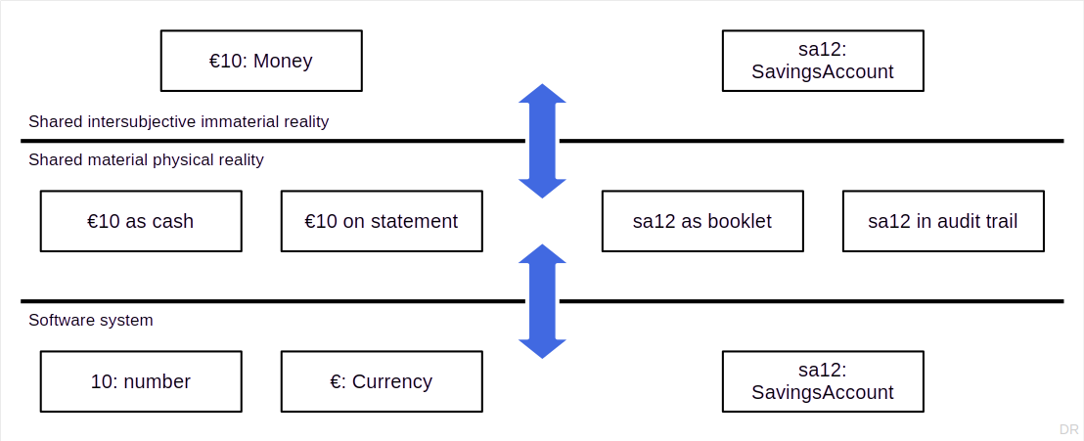
Occurrences and Representations of Objects and Values

Slide 9
Values and Objects in Programming Languages
There typically is no first-class concept of “value” [1]
Hence, values are often implemented as immutable objects
Mutable objects lead to side-effects, i.e. aliasing, a common source of bugs
[1] See https://dirkriehle.com/publications/1998-selected/values-in-object-systems/ for various techniques and approaches, some of which are discussed in this lecture

Slide 10
Advantages of Value Semantics
Using domain-specific value types
Brings your programming closer to the problem domain
Removes or restrain a major source of bugs (aliasing)
May enhance system performance (shared, immutable)
Lack of identity allows for free copying
No need for a separate database table to store values
Value objects can be serialized in-line for network transfer
No need for cross-process references in distributed systems

Slide 11
Object References (Identifiers)
Object identifiers are always values
In-memory object pointer
Handle (special type of pointer)
External object identifier
Primary keys
Object identifiers are not locations
But locations are often (wrongly) used to identify objects

Slide 12
2. Value Equality

Slide 13
The Java equals() Contract for Any Object [1]
Applies to any runtime object (whether a regular object or a value object)
Reflexive: For any non-null reference x, x.equals(x) should return true.
Symmetric: For any non-null references x and y, x.equals(y) should return true if and only if y.equals(x) returns true.
Transitive: For any non-null references x, y, and z, if x.equals(y) returns true and y.equals(z) returns true, then x.equals(z) should return true.
Consistent: For any non-null references x and y, multiple invocations of x.equals(y) consistently return true or consistently return false, provided no information used in equals() comparisons on the objects is modified.
Null-Object: For any reference x, x.equals(null) should return false.
[1] See https://docs.oracle.com/javase/8/docs/api/java/lang/Object.html#equals-java.lang.Object-

Slide 14
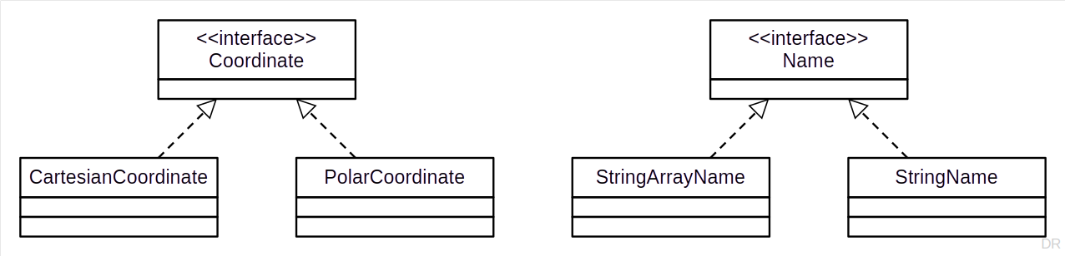
The Equality Contract for Value Objects
Like the equality contract for any object plus
An interface represents the value type
The implementation classes represent an equivalency set

Slide 15
AbstractCoordinate.isEqual() Implementation
export abstract class AbstractCoordinate implements Coordinate {
public isEqual(other: Coordinate): boolean {
return (this.doGetX() == other.getX()) && (this.doGetY() == other.getY());
}
...
}

Slide 16
3. Immutable Objects

Slide 17
Immutable Objects
Immutable objects are objects that
Have no mutation methods (never change their state)

Slide 18
Immutable Value Objects
Value types are often implemented as immutable object classes
(Former) mutation methods return another value object with the desired state
The result object may or may not be a new value object
export class CartesianCoordinate extends AbstractCoordinate {
...
protected doSetX(x: number): Coordinate {
return new CartesianCoordinate(x, this.y);
}
protected doSetY(y: number): Coordinate {
return new CartesianCoordinate(this.x, y);
}
...
}

Slide 19
Advantages and Disadvantages of Immutable Objects
Advantages
No side effects from aliasing!
Safe and perform well in concurrent programming
Disadvantages
Increased object creation
Your garbage collector may run hot quickly

Slide 20
Design by Contract and Immutable Value Objects
Preconditions
Don’t change
Class invariants
Are always the same: State did not change
Postconditions
Move to the result object

Slide 21
4. Shared Value Objects

Slide 22
Shared Value Objects
One value → one object

Slide 23
Advantages and Disadvantages of Sharing Value Objects
Advantages
Reduced (minimal!) memory consumption
(Parts of) equality test can be reduced to identity test
Hash code computation can be reduced to basic object hash code
Disadvantages
Added programming complexity
Performance penalty for organizing shared objects
Gets more difficult with more than one implementation class

Slide 24

How to Model a Postal Address? [1]
Questions to ponder
Does it have identity?
Can it change its state?
Does it have a life-cycle?
[1] Also https://forms.gle/5DMUnjuyspf8KoVg8

Slide 25
Handle / Body Idiom + Copy-on-Write [1]
The handle / body idiom
Separates handle (reference) from body (payload)
The handle is copied as the object is passed around
Copy-on-write
Keeps the handle through which the write happens but
Copies the body before mutation
This is a technique better suited than immutable objects for heavyweight objects
[1] Coplien, J. O. (1991). Advanced C++ programming styles and idioms. Addison-Wesley Longman.

Slide 26
5. The QuantityUnit Type

Slide 27
Design Exercise
Design a function that accepts a distance and a speed as the input
Compute and return the time it takes to go that distance at that speed

Slide 28
A Short Interlude About Requirements
Functional requirements missing
Precision of calculation?
What types of units?
…
Non-functional requirements missing
Speed of calculation?
Concurrent computation?
…

Slide 29
What’s Wrong With This Solution?
export function calculateDuration1(distance: number, speed: number): number {
return distance / speed;
}

Slide 30
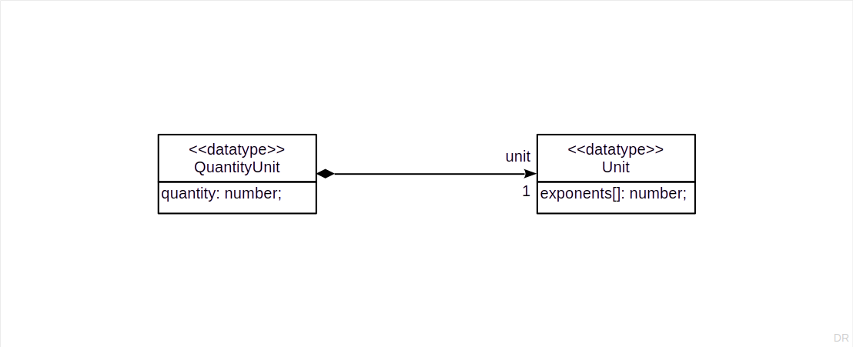
Introducing QuantityUnit

Slide 31
Base Units of the Metric System
Quantity | Base Unit | Symbol
Length | meter | m
Mass | kilogram | kg
Time | second | s
Electric current | Ampere | A
Thermodynamic temperature | Kelvin | K
Luminous intensity | Candela | cd
Amount of substance | mole | mol

Slide 32
Implementing (SI) Units
export class SIUnit {
protected exponents: number[] = [0, 0, 0, 0, 0, 0, 0];
constructor(exponents: number[]) {
this.exponents = [...exponents];
}
public isEqual(other: SIUnit): boolean {
return this.exponents.every((v, i) => v === other.exponents[i]);
}
public add(other: SIUnit): SIUnit {
IllegalArgumentException.assert(!other.isEqual(this));
return new SIUnit(this.exponents);
}
...
public multiply(other: SIUnit): SIUnit {
let result: number[] = [0, 0, 0, 0, 0, 0, 0];
for (let i = 0; i < this.exponents.length; i++) {
result[1] = this.exponents[i] + other.exponents[i];
};
return new SIUnit(result);
}
...
}

Slide 33
A Better calculateDuration() Function
export function calculateDuration2(distance: number, speed: number): QuantityUnit {
IllegalArgumentException.assertCondition(speed != 0);
return new QuantityUnit(distance / speed, new SIUnit([0, 0, 1, 0, 0, 0, 0]));
}
Possible improvements
Turn distance and speed into QuantityUnits
Have base units ready as Unit instances e.g. for seconds

Slide 34
5. Value Type Constructors

Slide 35
Value Type Constructors
Arrays, i.e. [ ]
Enumerations, i.e. enum
Parameterized types a.k.a. generics i.e. <...>

Slide 36
Enumerations as Value Type Constructors
Enums provide shared values out of the box
Immutability needs to be ensured by programming
Enums are great for documenting and type-checking codes!

Slide 37
Parameterized Types as Value Type Constructors
Common parameterized types are ranges and range restrictions [1]
[1] See https://github.com/jvalue/value-objects for a decent Java implementation

Slide 38
Parameterized Types as Value Type Constructors [1]
export class RangeBound<T> {
protected value: T;
protected inclusive: boolean;
constructor(value: T, inclusive: boolean) {
this.value = value;
this.inclusive = inclusive;
}
public getValue(): T {
return this.value;
}
public isInclusive(): boolean {
return this.inclusive;
}
}
export class Range<T> {
protected lowerBound: RangeBound<T>;
protected upperBound: RangeBound<T>;
constructor(lb: RangeBound<T>, ub: RangeBound<T>) {
this.lowerBound = lb;
this.upperBound = ub;
}
public includes(value: T): boolean {
let lowerValue = this.lowerBound.getValue();
let upperValue = this.upperBound.getValue();
...
}
public getLowerBound(): RangeBound<T> {
return this.lowerBound;
}
...
}
[1] A simplified version of https://github.com/jvalue/value-objects

Slide 39
Example Data From the GeBOS System [1]
The GeBOS was a large C++ software to operate cooperative banks
It had about 50 unique base domain-specific value object classes
It had about 20 unique constructors, generating hundreds of value types
It had more than 200 enums representing various domain-specific codes
[1] Bäumer, D., Gryzcan, G., Knoll, R., Lilienthal, C., Riehle, D. & Züllighoven, H. (1997). Framework Development for Large Systems. Communications of the ACM, vol. 40, no. 10, pp. 52-59.

Slide 40
Homework

Slide 41
Homework
Turn Name into a value type, including its implementations
Make all value objects immutable objects (no need for sharing)
You have to adjust the interfaces yourself (no template code provided)
Ensure implementations correctly fulfill the equality contract
Adapt your previous work to this homework as you see fit
Commit homework by deadline to homework repository

Slide 42
Summary
Values vs. objects
Value equality
Immutable objects
Shared value objects
The QuantityUnit type
Value type constructors

Slide 43
Thank you! Any questions?
dirk.riehle@fau.de – https://oss.cs.fau.de
dirk@riehle.org – https://dirkriehle.com – @dirkriehle

Slide 44
Legal Notices
License
Licensed under the CC BY 4.0 International license
Copyright
© 2012, 2018, 2024 Dirk Riehle, some rights reserved

